Slide 1
Prayer and Meditation
In the Primary School

Slide 2
Overview
Prayer
Meditation – research and practice
Prayer in the classroom
Resources

Slide 3
Prayer is turning the heart toward God. When a person prays, he enters into a living relationship with God.
Prayer is a gift one obtains through prayer.
YouCat 469
Notes:
YouCat defines prayer as …Prayer is turning the heart toward God. When a person prays, he enters into a living relationship with God.
It continues: Prayer is a gift one obtains through prayer
Like relationship –we need to be in it for it to grow.
Where do we begin? How do we pray?
We talk!

Slide 4
Three major expressions of prayer:
Vocal
Meditative
Contemplative
Notes:
The Catechism of the Catholic Church speaks of “three major expressions of prayer” (2699)

Slide 5
Vocal
“ While praying we should not try to think pious thoughts. We should express what is in our hearts and offer it to God as complaint, petition, praise and thanks. Often it is the great vocal prayers – the Psalms and hymns of Sacred Scripture, the Our Father, the Hail Mary – that direct us to the true substance of prayer and lead to a kind of free, interior prayer.”
YouCat 501

Slide 6
Meditative
“The essence of meditation is a prayerful seeking that starts with a sacred text or a sacred image and explores the will, the signs, and the presence of God.”
YouCat 502
Notes:
Basically it is a prayerful reflection on Our Lord aided by spiritual input: Scripture, Life of a Saint, rosary, image, icon.
Christian meditation is very different from eastern practices. It is entering into a time of awareness of God’s presence – the focus is Christ

Slide 7
Contemplative
“Contemplative prayer is love, silence, listening and being in the presence of God.”
YouCat 503

Slide 8
Prayer and Meditation
Meditative Prayer
Notes:
The following section was presented by Stacy Dodwell of St Monica’s Primary School Milton. Stacy recently completed the Masters at the University of Glasgow. The focus of her research was Meditative prayer in the primary classroom.

Slide 9
Defining Meditative Prayer
The aim is to develop a relationship with God!
‘Children, young people and adults should be taught to meditate on the Word of God in personal prayer (CCC, 2688)
Notes:
In the Christian tradition the aim is to develop a relationship with God.
The following quote from the Catechism not only highlights the importance of meditative prayer but also suggests that it is something that we must be taught/learned. For us, in the Catholic primary school, its something that we can teach our pupils to do gradually.

Slide 10
Why meditative prayer?
Primary 6/7 class
Changes in behaviour:
- Less aggressive
- Take thinking time
- Improved concentration
- Improved literacy skills
- Discuss Scripture
Notes:
Stacy first used Meditative Prayer with a Primary 6/7 class. The class: challenging behaviour, Friday afternoon slot between subjects P.E. and Golden Time which was particularly difficult – decided to use meditative prayer.
Over time the following changes in behaviour were noticeable: (slide)

Slide 11
Research
Aim:
To explore the use of meditative prayer in the classroom from the perspective of the class teacher!
Notes:
This then became the focus of research as part of the Masters.

Slide 12
Research
What do teachers consider to be the main features of meditative prayer?
How prepared do teachers feel to lead this aspect of the curriculum?
When using meditative prayer in the classroom, what would be the desired effect on your pupils?
Does the use of meditative prayer inform any other aspects of your teaching?
What challenges do teachers face in the classroom when using meditative prayer?
Notes:
As part of the research teachers and pupils within the school were asked to participate in Meditative Prayer and record feedback/experience of it. The staff were asked the following questions:

Slide 13
Results - Themes
Relationship with God
Calm atmosphere
Reflection
Prepared
Not prepared
Change in behaviours
Literacy
Health and Wellbeing
Time constraints
Reluctance/Disruptive behaviours
Children enjoy participating
Whole school approach required
Other
Notes:
The following themes emerged from the responses:

Slide 14
Links to CfE
Developing skills of reflection
Developing interdisciplinary learning
Direct curricular links to literacy, health and wellbeing and religious education
Notes:
Direct links to core aspects of the curriculum:

Slide 15
Challenges
Involving ASN children
Finding a ‘quiet place’
Time constraints
Notes:
The main challenges to using meditative prayer in the classroom:

Slide 16
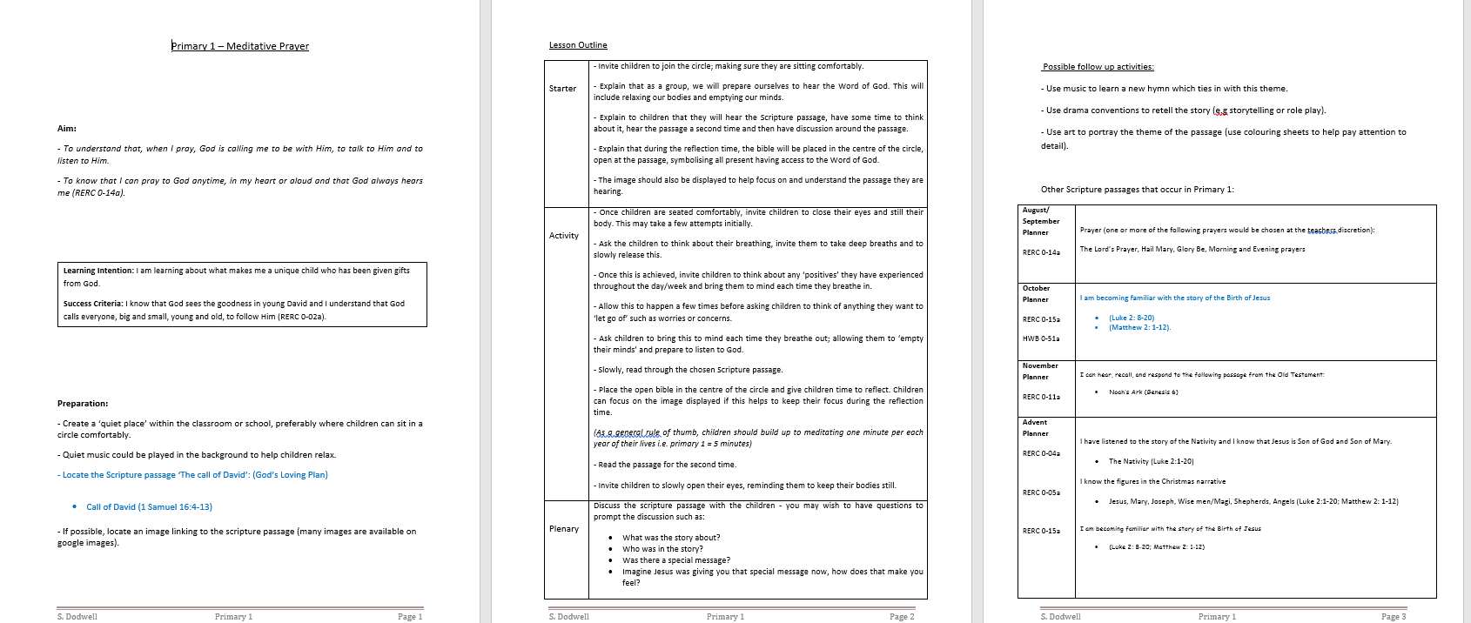
Resources
Notes:
The majority of teachers felt that a whole school approach was required. Stacy has since developed resources to help staff to plan a meditative prayer session. These are available to download on the RE Department’s website.

Slide 17
Prayer and Meditation
In the Primary Classroom
Notes:
In this part of the presentation we are going to look at practical ways of enhancing the prayer life of the pupils in our classrooms but also in the wider school community

Slide 18
What are we aiming for?
Provide pupils with meaningful prayer experiences
Assist pupils in developing the language of prayer
Teach pupils the traditional prayers of the Church
Help pupils to develop habits of prayer
Notes:
So what are we aiming for?

Slide 19
Planning for Meaningful Prayer Experiences
Format
Timing
Music
Focal point (liturgical colour, image, icon, candle, scripture)
Posture
Relevant
Wider Community of Faith
Notes:
In order to provide meaningful prayer experiences for the pupils in our class we need to take time to plan and consider what the experience will look like.
So the first thing is to ensure that it is age and stage appropriate. Both in the sense of the format that we adopt but also in the timing of the prayer experience. It is also important to provide a variety of types of prayer experiences throughout the year such as (meditative, reciting prayers together such as the rosary, prayer service – scripture, intercessions, hymns etc.)
With regards to timing – it is important to keep prayer experiences in the classroom short initially and build up – naughty step – general rule of thumb is that children should be able to sit in quiet prayer for 1 minute for every year of their life.
It is important that the pupils realise that this is a different type of experience from other learning activities that take place in the classroom – this is time for them to communicate with God – so a change in the ambience is helpful – reduce the lighting – having an LED candle (as most schools are no longer allowed to light candles) – quiet Music in the background can help to settle the children, breaks the silence and signifies a change in tone.
Focal point (liturgical colour, image, icon that is connected to theme of the prayer, scripture open)
Posture (breathing and relaxation exercises) training the children to clear their minds, still their bodies is an important life skill – relaxation – HWB but it is essential in order for them to focus on the prayer that they’re about to participate in.
Relevant – we are naturally very good in primary schools at praying for pupils intentions and for global and national issues that occur such as people affected by natural disasters etc. but making sure that the pupils are aware that we are obliged to pray for others and that prayer experiences are both relevant to them and also issues in the wider world.
Prayer connects us to the wider community of faith. Opportunities for pupils to participate in activities based on prayer through homework tasks encouraging prayer at home, opportunities for the school to gather together to celebrate feast days, devotions, First Friday Mass, where possible to gather together with members of the parish community to pray together.

Slide 20
Developing the Language of Prayer
Notes:
It is important to take time to discuss prayer with children and to emphasise that it is a conversation with God. There are times when use traditional prayers of the Church, there are times when we use our own words to formulate prayers in thanksgiving for something or to communicate something we are concerned about but its also important to encourage children to engage in a conversational style of prayer where they entrust their worries/concerns to God and also to emphasise that all conversations require times when we are silent and listen.
There are a few different ways of making this more tangible for children that we will look at now.

Slide 21
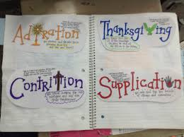
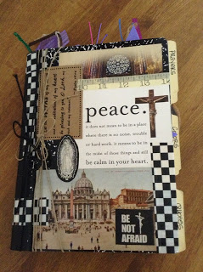
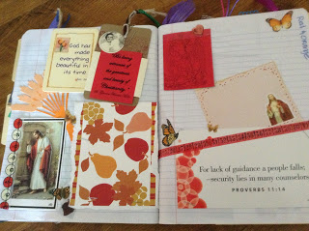
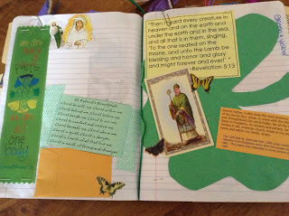
Prayer Journal
Notes:
The first is the prayer Journal.
I really liked this idea which I found on a website called Look to Him and Be Radiant. (details later) This version is for older children but it could easily be adapted fro younger children by having them illustrate rather than write. For older children they can record what they are learning about types of prayer, reflections after meditation, favourite prayers that they’ve gathered, quotes from scripture that you want the to reflect on and so on. It becomes like a diary of their conversations with God, their reflections on their own personal faith journey.

Slide 22
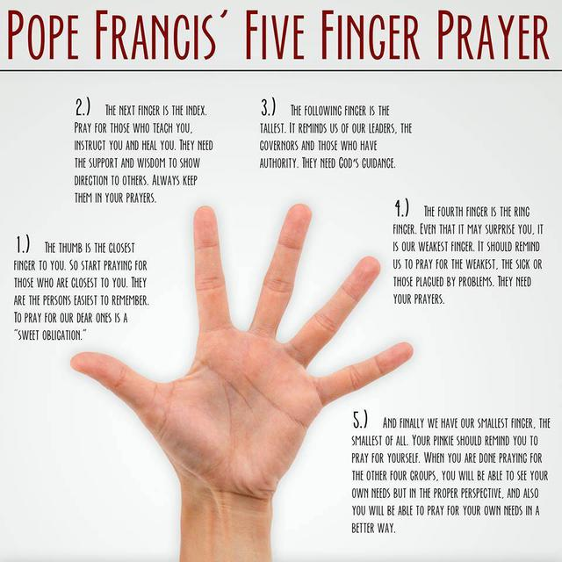
Notes:
To encourage children to pray for others Pope Francis uses the five finger prayer.
Thumb – closest to you – pray for those closest to you
Index finger – pray for those who teach you
Tallest finger – pray for our leaders
Weakest finger – pray for those who are sick, suffering
Smallest finger – pray for yourself – perspective after prayer for others.
Various activities to help children to learn this method online – this I found on Look to Him and Be Radiant

Slide 23
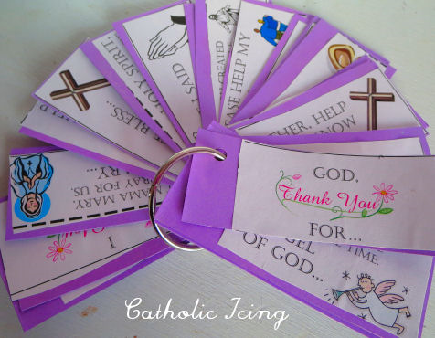
Prayer Key Ring
Adoration
Contrition
Thanksgiving
Supplication
Notes:
The Prayer keyring was another good idea to encourage children to structure their prayer and to remind them to include the various types of prayer available at Catholic Icing .com

Slide 24
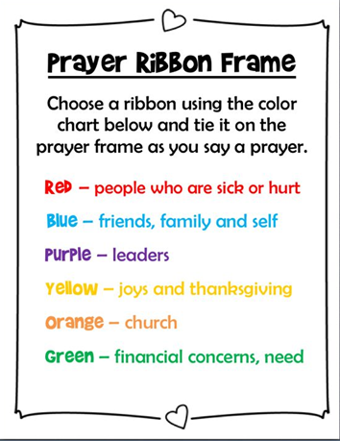
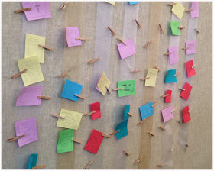
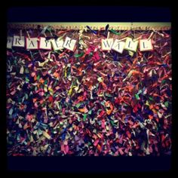
Notes:
Another tangible way to encourage children to pray for others is the prayer ribbon wall / frame. It can also be helpful to see if we give preference to one type of prayer over another.

Slide 25
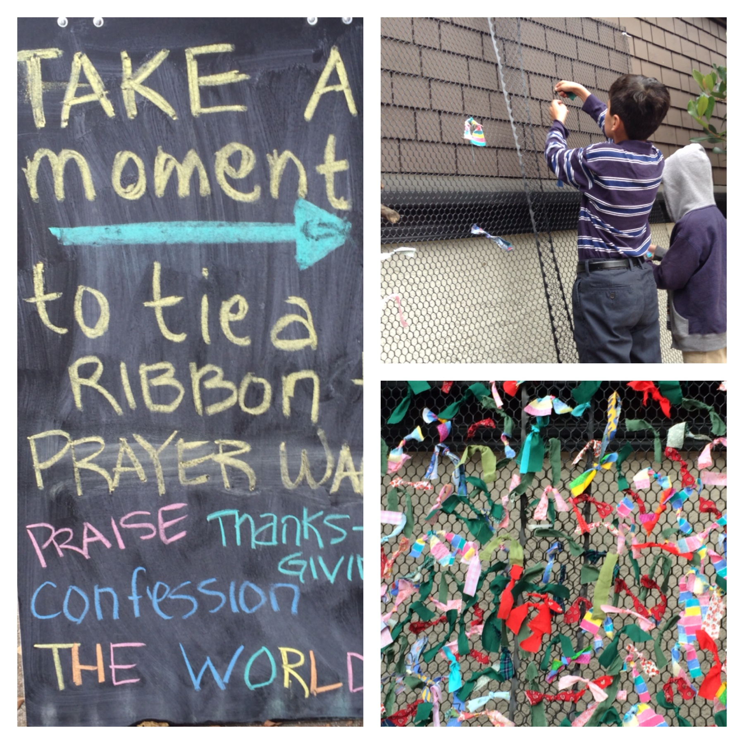
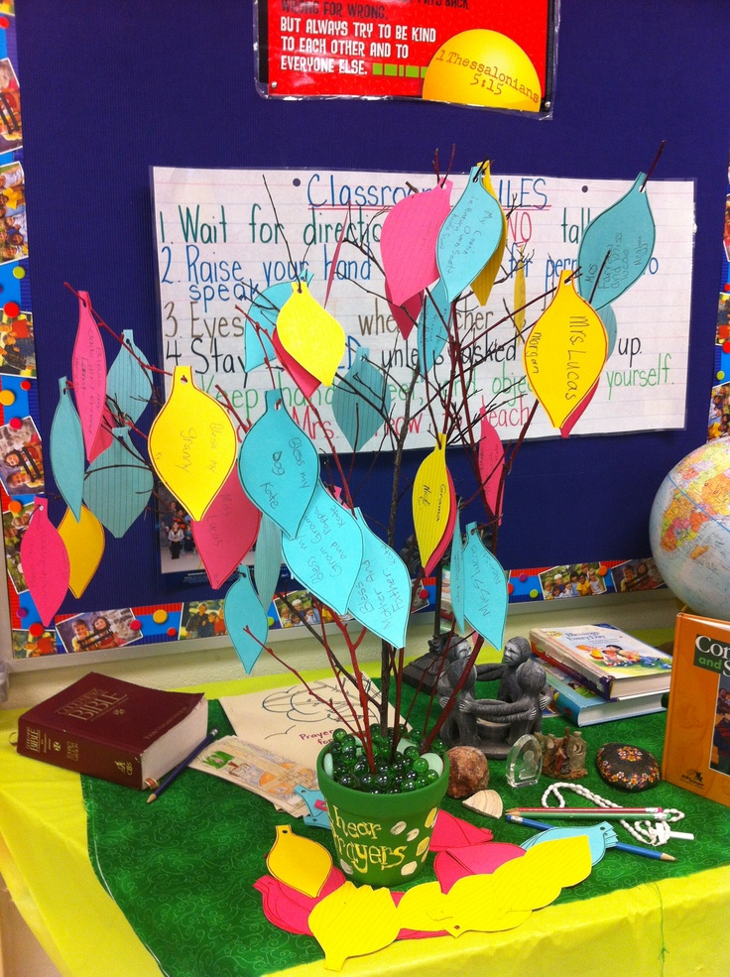
Notes:
Various versions

Slide 26
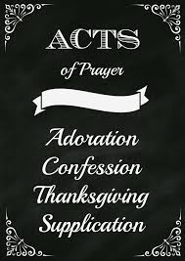
Traditional Prayers of the Church
Memorization
Adoration
Litanies
Rosary
Stations of the Cross
Procession
Notes:
Participating in the traditional prayers of the Church also helps children to feel like part of the wider community of faith.
Knowing the traditional prayers of the Church by heart is a gift for life –are give pupils the gift of prayer – there are many ways of encouraging children to learn things by heart – many strategies that we use in other curricular areas that we can apply. Setting them to a tune, cooperative learning strategies helping our group to learn, prayer book (flick forward)
Asking your school chaplain to arrange time for short periods of adoration is really important in helping children to understand the true presence in the Eucharist. Allows children time to engage in quiet reflective prayer
Litanies – can be a useful way of encouraging pupils to participate in whole class prayer – litanies to Mary. Thanksgiving, saints, depending on age and stage structure
Again in primary schools we are very good at connecting traditional prayers such as the rosary and stations of the cross to the liturgical year and the seasons of the Church. But being creative in how we encourage the children to engage with these prayers can help them to approach them with renewed enthusiasm. This could be done by asking each class to design a station for each mystery of the rosary / station of the cross (large frame to display them in). These can then be displayed throughout he school or in space where the children can visit a different station throughout the season. In the month of May – you could have outdoor stations for the mysteries of the rosary if you have a nice garden area.
Rosary - many schools also have rosary groups during the month of May and October - before school/ lunchtime – these can be led by pupils and can be an opportunity to invite parents to join
Procession – May, Corpus Christi, Patronal – again an opportunity for parents, member of the parish community to join helping us to develop as a community of faith.

Slide 27
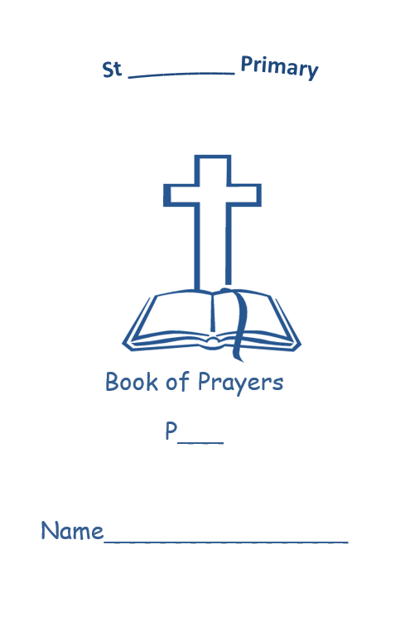
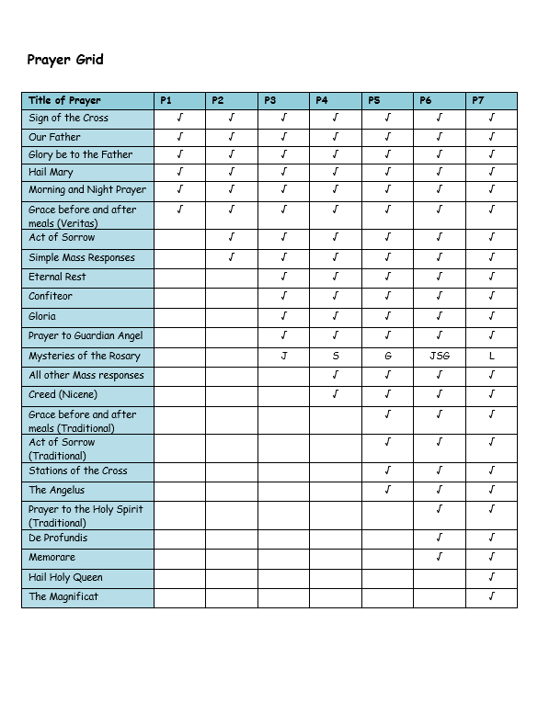
Prayer Book:
Homework
Sequencing
Cut and stick
Missing word
Illustrate
Notes:
Available to download from our website:
Has the grid with the prayers for each stage from This Is Our Faith. The prayer book can be printed and sent home with homework tasks tor reinforce the learning of the prayer and also to encourage the pupils to pray with their parents/guardians.

Slide 28
Examination of Conscience
Pray as You Go - The Examen
Notes:
Encouraging children to develop habits of prayer is important and many ways of developing prayer that we have looked at already will encourage them to do this. It is also important that we model our habit of prayer – when we gather together, preparing for something, sharing our experience of prayer.
It is important to encourage them regularly reflect on their day and examine their conscience. This can be done by using the examen – a prayer of review which encourages a short reflection back over the day, recalling events and considering your feelings. The purpose is to become more aware of the ways in which God has been present to you and to consider your actions throughout the day.
Pray as You Go is an excellent resource for prayer and meditation and they have a lovely examen for children which we will have a listen to now.

Slide 29
Resources

Slide 30
Resources
Pray as Go – www.pray-as-you-go.org/home
Come Pray the Rosary – www.comepraytherosary.org
Catholic Icing - www.catholicicing.com
Look to Him and be Radiant - www.looktohimandberadiant.blogspot.co.uk
Notes:
Pray as You Go – daily reflection on the Gospel of the day , breathing exercises, relaxation exercises, the examen
Come Pray the Rosary – tells you how many other people are praying the rosary at that time – leads you through the rosary
Catholic Icing – templates (keyring) and useful ideas for prayer
Look to Him an Be Radiant - Templates and prayer ideas – journal, 5 finger prayer etc

Slide 31
