Slide 1
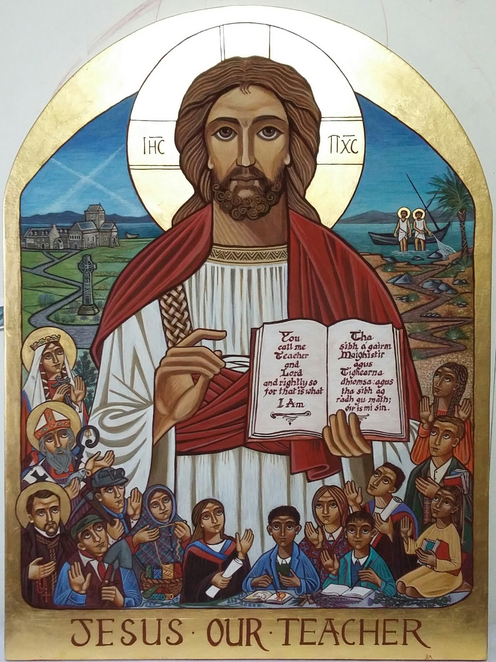
Catholic Schools: Good for Scotland
1918 - 2018
Catechists Year 1 & Year 2

Slide 2
The Catholic Community in Scotland Before 1918
Before 1775: about 1% of the population were Catholic
1775: Irish Catholics workers come to work constructing canals, and are then joined by their families
1820: 25,000 Irish Catholics in Scotland
1840: 126,321 Irish Catholics in Scotland, (40,000 in Glasgow alone)
1848: Reports of an average of around 1,000 Irish immigrants to Scotland each week
1851: 207,000 Irish-born immigrants in Scotland – 7% of the population
Notes:
This is just basic information on the pace and extent of the growth of the Catholic population in the years leading up to the Education Acts of 1872 and, more importantly, 1918.
POINTS TO NOTE:
Prior to 1775: RC population is a tiny percentage, and is mainly concentrated in the far north and the Isles, for example in Barra, South Uist and the North East.
Not all Irish workers who come are RC, but the vast majority are. There is very little religious or cultural provision for them, so they are seen as very different and troublesome: experience discrimination. They tend to live in the poorest areas and be confined to low paid manual labour
Pace of community growth: from almost none to 25,000 over 45 years is fairly slow compared to change from 1820 – 1840: a 5-fold increase in only 20 years. Majority settle in industrial and mining areas of Greater Glasgow and Lanarkshire, although some settle in Dundee and Lothian.
By 1851: 207,000 first generation migrants from Ireland. 31 year span from 1820 – 1851 sees Irish immigrant population grow more than eightfold.
This leads to a certain resentment and suspicion from some elements of the native population, exhibited through overt discrimination, even at the very highest levels.

Slide 3
The Catholic Community in Scotland Before 1918
1880 – 1914:
Italian Catholic migrants begin to arrive, escaping poverty
Lithuanian Catholic migrants arrive, driven out of their own country by Russian suppression (about 7,000 by 1914)
Significant numbers of Polish Catholic migrants arrive in Scotland
Notes:
This is just basic information on the pace and extent of the growth of the Catholic population in the years leading up to the Education Acts of 1872 and, more importantly, 1918.
POINTS TO NOTE:
Italian community – mainly escaping poverty due to changes in agricultural practice and increased industrialisation in the north of Italy. They tended to disperse in small groups across the country, working in catering (cafes, ice-cream parlours, fish and chip shops)
Lithuanian community – escaping poverty but also cultural and religious suppression from the Russian government. They settled and worked in mining areas, particularly in Ayrshire and Lanarkshire. They experienced fierce discrimination
Polish community – also settled in poorer industrialised areas of the Lothians, Fife and Central Belt. Although anti-Catholicism was very strong in all these areas, the Polish workers won some respect from fellow workers due to their willingness to join and fully participate in trade unions.
Other nationalities arrive, but not in such significant numbers
Draw an explicit link between the experience of our Scottish Catholic community as immigrants, and the current reaction to immigrant communities

Slide 4
Before the 1918 Education Act(Scotland)
Most children not in school
Schools run by voluntary organisations
1872 Education Act aims to regulate schools, introducing state funding, but doesn’t take account of faith schools
Catholic community is therefore contributing to state schools but, in addition, having to fund their own schools
Notes:
In the 19th century, state schools provided education to the people of Scotland but Catholic families generally felt it was important that their children attended a school where their Catholic faith was taught.
Voluntary schools, often housed in local parish halls began to emerge, often known as voluntary schools. These schools received some grants from central government but the majority of the funding was made by the Catholic community themselves. This was a real burden on these families as, during this time, the Catholic community were amongst the poorest in the country. The catholic families were still legally bound to pay their rates which would be used in part to fund the public schools but didn’t fund the schools their own children attended. Most of the funds were paid directly to the schools at a rate of threepence or fourpence per week but the Catholic community as a whole supported these schools through balls, concerts, bazaars and charity sermons.
The St Vincent De Paul Society also gave financial support to allow children from the very poorest families attend a Catholic school. Even with the best efforts of the voluntary schools, the cost of educating such a huge amount of children was beyond the Catholic community. This meant the Catholic schools were very underfunded, over-crowded and lacked even the basic resources the children needed.
Many areas, especially in Glasgow relied heavily on the Religious Orders. It was largely the contribution of these Priests, Sisters and Brothers who helped to run the schools and made it feasible for children to have access to a Catholic Education. The 5 orders in Glasgow were The Franciscans, The Marists, The Sisters of Mercy, the Jesuits and the Sisters of Notre Dame. It is important to highlight that, without the three female Religious orders, it is highly unlikely there would have been secondary education for Catholic girls. Throughout Scotland, this pattern of Catholics creating and running their own schools was set.
Whilst still paying their taxes to fund state schools, from 1872, large sums of money had to be raised to build and equip new Catholic schools, putting a tremendous financial burden on an already mainly impoverished Catholic Community.
This gargantuan effort did not go unnoticed by the Government at the time and indeed this considerable task was recognised in the Report of the Committee on Education in Scotland 1874-75 which refers to ‘the extraordinary efforts of the Roman Catholic Church is making for the education of her own children, while Catholics, like others, are rated for public schools’. This committee recognised that Catholics were paying twice for schools. Unfortunately, the sad fact was, that in terms of buildings, staffing and equipment, Catholic schools, and therefore Catholic children, were at a real disadvantage.

Slide 5
The 1918 Education Act (Scotland)
All state-funded schools would be regulated and inspected to ensure quality education
Church agrees, with the condition that Catholic schools teach the faith and have approved teachers
Catholic schools enabled to keep connections with religious teaching orders and local parishes
Catholic schools, though primarily serving the Catholic community, were open to all children.
Catholic community now has schools funded in the same way as all other schools.
The 1918 Education Act promised “schools fit for heroes”.
Notes:
The 1918 Act tried, for the first time, to standardise and regulate expected standards in the running of and the curricula in schools. This meant that government inspectors could now check on standards of provision in schools. This was a huge step forward in general provision but, with no specifically Catholic inspectorate, the Church made the condition that they could be part of the process for selecting the staff in Catholic schools, and that local clergy would be able to be involved in the day-to-day running of the schools. It also allowed for continued connection between the schools and the religious orders which had done so much for the voluntary schools, and who provided a well-educated pool of teaching and management staff.
Another important point was that, as Catholic schools were now state-funded, they were officially open to all. This seems to have been the case among the voluntary schools prior to this – it would seem that a community itself composed in the majority by immigrants had an understanding of how it felt to be an outsider, and allowed other groups to use their schools. However, the reality of immigrant communities is that they often settle within national/cultural groups in one area, perhaps finding strength in numbers, so the vast majority of pupils in schools are the children of one particular migrant Catholic groups.
In addition, Catholic families no longer had to pay twice for education. They no longer had to pay for the voluntary schools and this meant that Catholic families – traditionally large families – could afford to have all of their children educated. This marked a real turning point in the academic, financial and social fortunes of the Catholic community.

Slide 6
Catholic Schools Today – A Success Story
“…Catholic schools are now viewed in many quarters as making not only a valuable contribution to the development of citizens and to the common good in a pluralist democratic society, but also in certain respects succeeding in achieving these aims more effectively than their public school counterparts.” (Terence McLaughlin, author, The Contemporary Catholic School)
“There is still a sense of community amongst those people and that the community arises from their common origins, common cultural thinking, practices etc.” (Dr Joseph Bradley, University of Stirling)
“Research produced in recent years shows that Catholic schools are academically successful and surpass most other schools when taken like for like.” (Dr Joseph Bradley, University of Stirling)
“ What is clearly demonstrable is the fact that Catholic schools, in terms of academic success, have never been better. Report after report, after the visits of HMI, give us conclusive evidence of this.” (Bishop Devine)
Notes:
Charter – the building of a Catholic ethos does not happen through chance; it is the result of a commitment to the teaching of Jesus Christ; those things we so often refer to as “Gospel values”. This happens certainly in the content of our RE programme, but it is so much more than that. And vitally, it must be consistent and practiced with integrity. It is not by accident that, of the ten bullet points in the Charter, seven of them ask for a commitment. There is so much change in the world of education and the day to day life of a school.
Perhaps part of the success of Catholic schools is that sense of a commitment to the living of eternal truths: that no matter what is happening in legislation, in society, in educational thought, the basic characteristics of the Catholic school will not change. For our young people, they are at a stage of their lives characterised by change; they can explore this within a context where they can have certainty that the “goalposts” are not always moving. Young people can thrive in a context where they feel secure. A secure learner is a better learner.
It is also frequently said that we cannot really define an ethos, or prove it. It is important to point out that there is sound, rigorous statistical evidence that Catholic schools do in fact perform well in terms of all measureable indicators. “Report after report . . .” as the final quote says. The Act meant that Catholic schools are assessed against the same criteria as non-denominational schools, and do very well . However, our Charter, and our faith, calls us to more than a commitment to good statistics.
INVITE DISCUSSION and QUESTIONS

Slide 7
The Role of Parents in that Success
“The bottom line is that, as long as parents go on choosing Catholic schools, they will need to continue to exist. “
“I think parents are very clear. I think parents are clearer than ever before what they want in education for their children. Parents know more about schools than they ever knew, parents are in schools more often, they get more information from the media and I think parents are very, very clear about what they want. Things like the Parents Charter has sharpened or brought into focus what parents want for their children so they know more about what goes on in schools and I honestly believe and I think it is seen with Catholic parents, they know what they are sending their children to…”
All quotes taken from interviews contained in Catholic Schools in Scotland: Mapping the Contemporary Debate and their Continued Existence in the 21st Century. (McKinney)
“If I had children [of school age] I would still want them to be educated in it, even if at the end of their educational experience they decide this is not for me in terms spiritual or religious commitment, I do think it conveys certain values and I think also it is quite important from the point of view of the identity.”
Notes:
Perhaps one of the most telling pieces of evidence of the worth of Catholic schools comes from the parents who choose them for their children and young people. Our government, quite rightly, is becoming increasingly aware of the importance of the parental voice in the education debate. The proposals in the new “Empowering Schools” document places parents within the consultative and improvement process for Scottish schools.
It is therefore worth noting that not only is the choice to send a child to a Catholic school a parental choice: it is in the vast majority of cases a repeated parental choice: most pupils in Catholic secondaries were previously at Catholic primaries. In other words, parents have seen what Catholic education can offer their child, and choose to continue with it into secondary school. Again, very often, they choose the same experience for younger siblings. And this at a time when, as the second quote says, parents have access to more knowledge and more freedom than ever before.
Important to say, also, that we do not measure our success in terms of the number of Catholics we “churn out” (reference last quote). We build a context in which young people see themselves as people of innate dignity and value, who are invited into relationship with God, and support ed by the Church to accept and live that invitation. We make space for God to work. The choice to accept that invitation is personal to all of us, however, and may be a choice which ebbs and flows throughout our lives. We equip and empower young people to make their own informed decisions, and to make them throughout their lives, secure in the knowledge that this invitation is never taken back. In this, teachers and leaders in Catholic schools must serve as an example of how the choice to live as an active Christian does not belong to the past, but is a viable choice in the 21st century.
INVITE DISCUSSION and QUESTIONS

Slide 8
1918 - 2018
Catholic Schools: Good for Scotland
Notes:
The emphasis again then on the idea that Catholic schools are not just good for Catholics, but good for Scotland. They operate well in supporting our young people to become successful learners, confident individuals, effective contributors and responsible citizens, and this is the duty of all schools in Curriculum for Excellence.
It also however makes explicit that we do not do this just to equip them for “when they leave school”, as if their lives were somehow on pause until that point. We remind them that they can be all these things now; they are agents for change now; they are decision makers now; they are in relationship with God, others and self now.
The journey to discipleship is a life-long journey of learning, and we take what we learn out into the world.
GIVE OUT COPIES OF THE CHARTER AND ALLOW TIME FOR GROUP DISCUSSION AND FEEDBACK ON IT AND ON ANY PART OF THE PRESENTATION.

