Slide 1
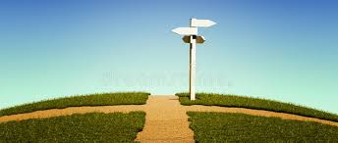
Faith at the crossroad of the pandemic
A chance for a new way of living

Slide 2
What are your steps to recovery?

Slide 3
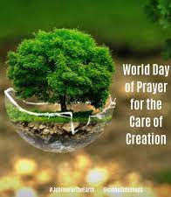
MESSAGE OF HIS HOLINESS POPE FRANCIS FOR THE WORLD DAY OF PRAYER FOR THE CARE OF CREATION
1 SEPTEMBER 2020
A time to remember
A time to return
A time to rest
A time to restore
A time to rejoice
“we will emerge either better or worse after the pandemic”

Slide 4
A time to remember
Why is your Catholic school important post pandemic?
This is indeed a time of grace to remember our school’s original vocation to exist and flourish as a community of love.
We need constantly to remember that “everything is interconnected, and that genuine care for our own lives and our relationships with nature is inseparable from fraternity, justice and faithfulness to others” (LS, 70).

Slide 5
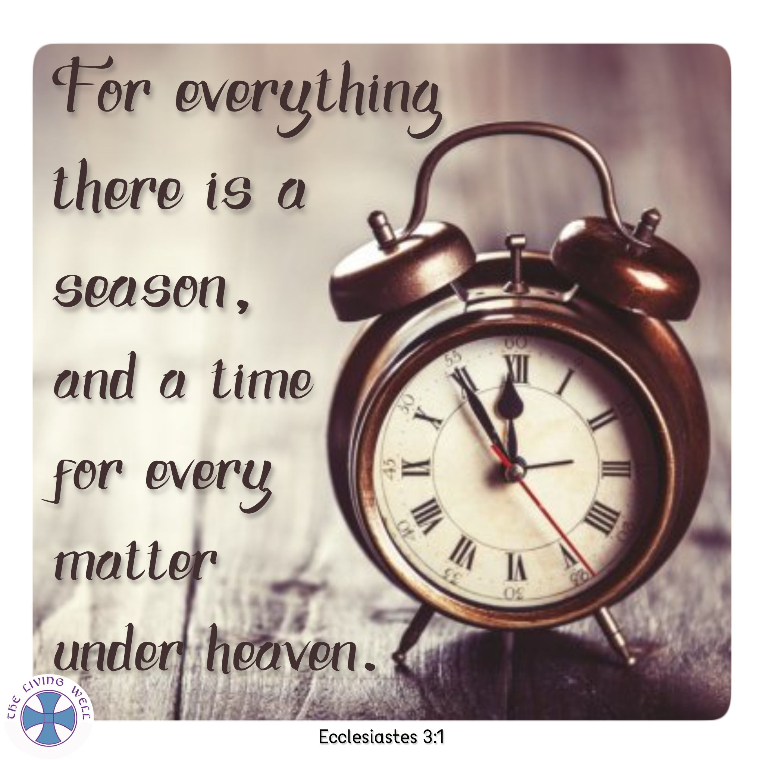
A time to return
This is a time to turn back in repentance. Have we have broken our relationship with the God, with our fellow human beings, and with the rest of creation?
How can we think once again of our fellow human beings, especially the poor and the most vulnerable?
How do we ensure we are not in competitive scramble with others, but are in joyful fellowship, supporting and protecting one another?

Slide 6
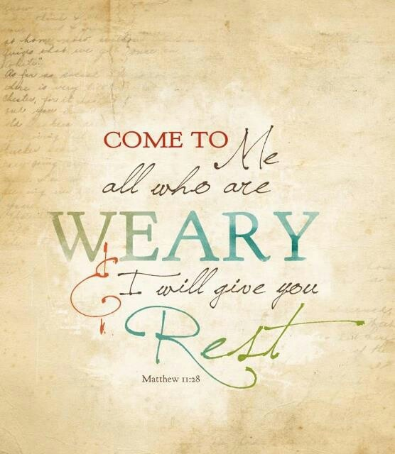
A time to rest
In some ways, the current pandemic has led us to rediscover simpler and sustainable lifestyles.
The crisis, in a sense, has given us a chance to develop new ways of living.
Already we can see how the earth can recover if we allow it to rest: the air becomes cleaner, the waters clearer, and animals have returned to many places from where they had previously disappeared.
The pandemic has brought us to a crossroads.
We must use this decisive moment to end our superfluous and destructive goals and activities, and to cultivate values, connections and activities that are life-giving.

Slide 7
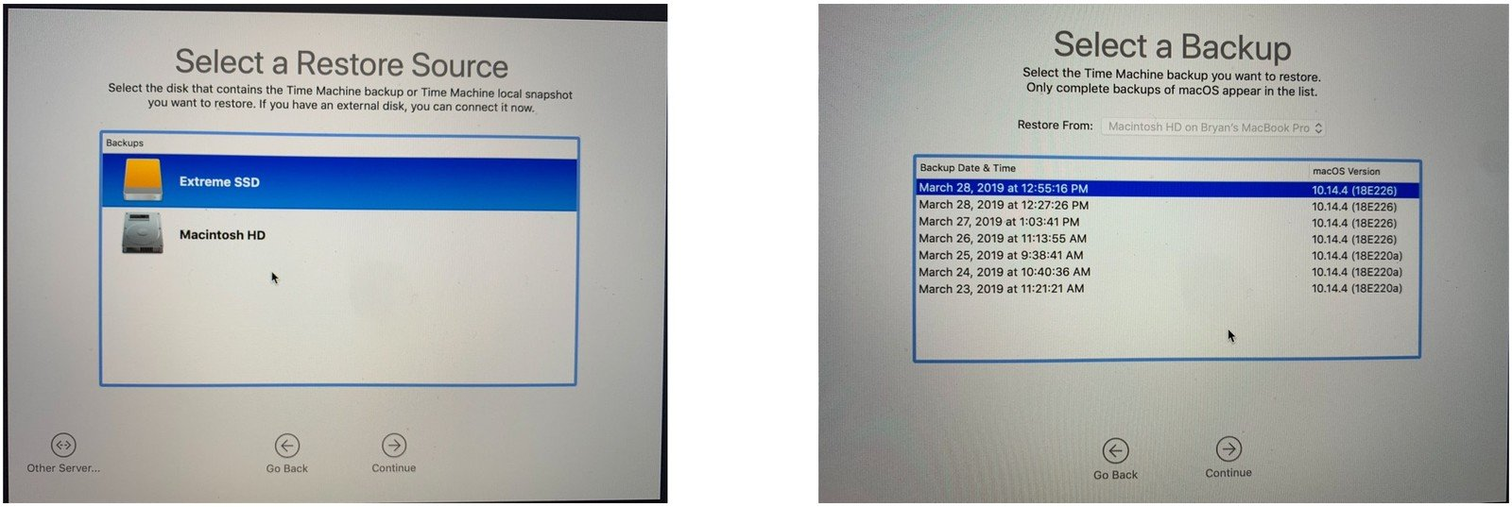
A time to restore

Slide 8
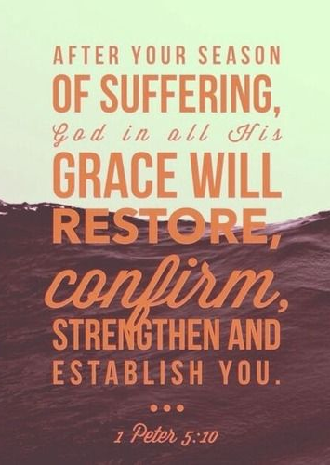
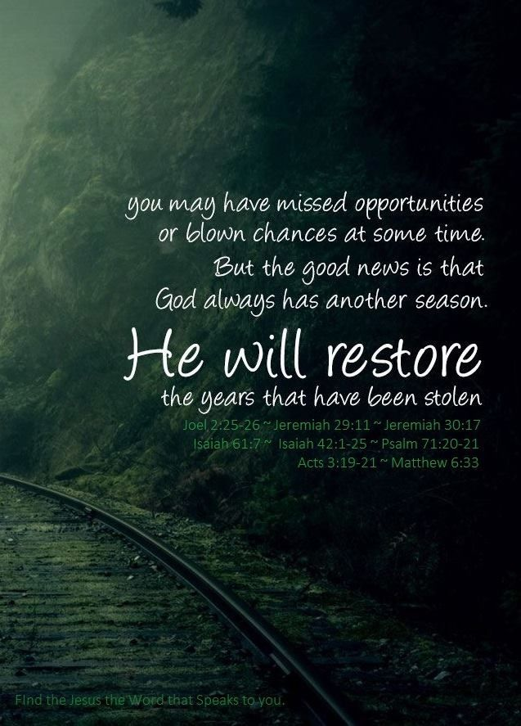
A time to restore
It is a time to restore the original harmony of creation and to heal strained human relationships.
What do you want to restore in your school to the original state?
What are you willing to fight for?
It is a time for:
restorative justice
recovery packages
biodiversity restoration

Slide 9
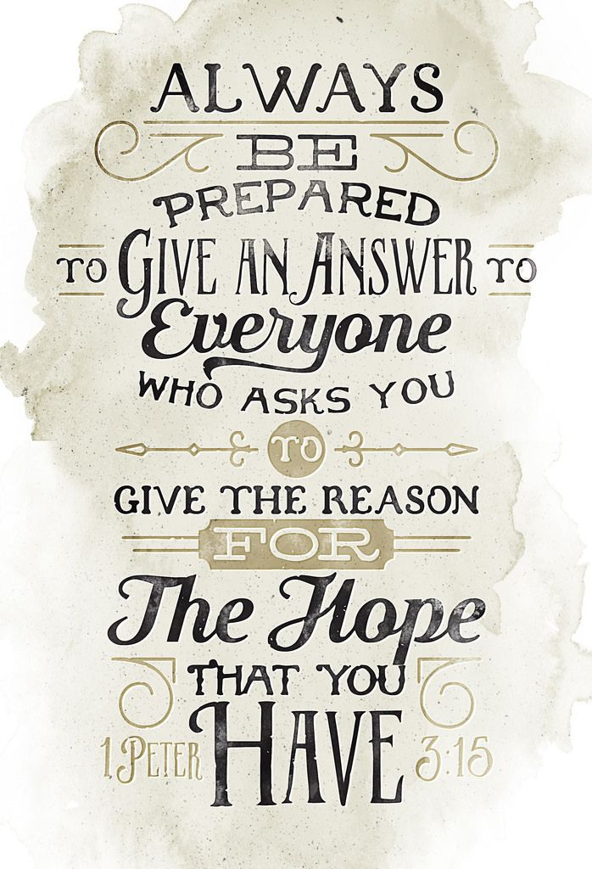
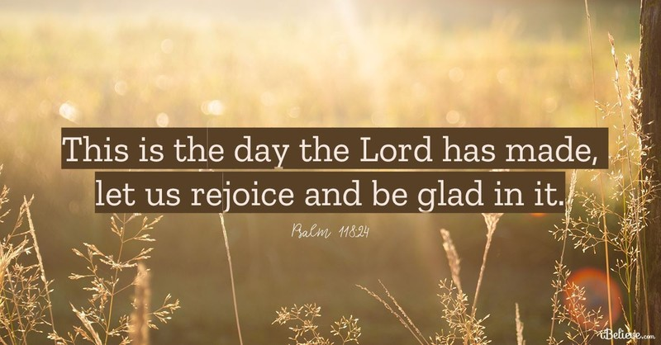
A time to rejoice
We rejoice too that faith communities are coming together to create a more just, peaceful and sustainable world.
This year should lead to long-term action plans…
inaugurated by a trumpet blast resounding throughout the land

Slide 10
In asking us to prepare the future, I believe that Pope Francis is urging us never to return to the “old normal” which gave way to deep gaps between the rich and the poor, serious ecological damage and violence within our own families and in all of society. God now invites us to co-create with Him a new world built on love, justice, equality, and access to decent and dignified work, education for all, and health care for everyone in need regardless of their ability to pay for such care. Through its moral leadership and universal outreach, the Catholic Church should inspire change of policies, practices, and behaviour at all levels, from heads of government to key decision-makers, to religious leaders and people of faith, to grassroots communities.
we will emerge either better or worse after the pandemic

Slide 11
Pope Francis asked the COVID 19 Commission to
prepare the future
NOT
prepare for it.
we will emerge either better or worse after the pandemic

Slide 12
In asking us to prepare the future, I believe that Pope Francis is urging us never to return to the “old normal” which gave way to deep gaps between the rich and the poor, serious ecological damage and violence within our own families and in all of society.
God now invites us to co-create with Him a new world built on love, justice, equality, and access to decent and dignified work, education for all, and health care for everyone in need regardless of their ability to pay for such care. Through its moral leadership and universal outreach, the Catholic Church should inspire change of policies, practices, and behaviour at all levels, from heads of government to key decision-makers, to religious leaders and people of faith, to grassroots communities.
we will emerge either better or worse after the pandemic

Slide 13
prepare the future, never to return to the “old normal” of deep gaps between the rich and the poor, serious ecological damage and violence within our own families and in all of society.
Co-create a new world built on love, justice, equality, and access to decent and dignified work, education for all, and health care for everyone in need
Through its moral leadership and universal outreach, the Catholic school should inspire change of policies, practices, and behaviour at all levels,
“we will emerge either better or worse after the pandemic”

Slide 14
What are your steps to recovery?
Why is your Catholic school important post pandemic?
A time to remember
A time to return
A time to rest
A time to restore
A time to rejoice
What are you willing to fight for?
“we will emerge either better or worse after the pandemic”

