Slide 1
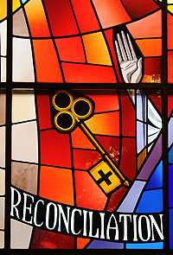

Reconciliation
Parish Catechesis Session One
Notes:
Welcome to session 1 of our online catechesis for Reconciliation.
My name is Joanna and I am going to take you through today’s lesson.

Slide 2

That we are all God’s children
That we are members of our local parish community
Notes:
In today’s lesson we will be learning that we are all God’s children and that we are members of our parish community.

Slide 3
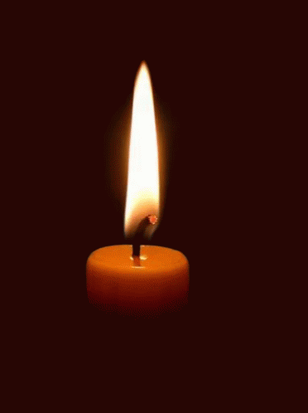
Time of Prayer
Notes:
We are now going to take a few moments to pray before we begin our lesson today. Make sure you are sitting comfortably, take a few moments to prepare yourself for prayer and then join me in making the sign of the cross.
In the Name of the Father and of the Son and of the Holy Spirit Amen.
God Our Father, You are with us as we gather in prayer. Open our hearts as we listen to your word and help us to prepare well to receive the Sacrament of Reconciliation. Amen
After Jesus had risen from the dead he appeared to his disciples to give them an important message. We are going to listen to a short passage from Matthew’s Gospel that explains this to us now.
Jesus Appears to His Disciples
¹⁶ The eleven disciples went to the hill in Galilee where Jesus had told them to go. ¹⁷ When they saw him, they worshiped him, even though some of them doubted. ¹⁸ Jesus drew near and said to them, “I have been given all authority in heaven and on earth. ¹⁹ Go, then, to all peoples everywhere and make them my disciples: baptize them in the name of the Father, the Son, and the Holy Spirit, ²⁰ and teach them to obey everything I have commanded you. And I will be with you always, to the end of the age.”
Let’s bring our time of prayer to a close by praying the Glory Be to the Father:
Glory be to the Father and to the Son and to the Holy Spirit Amen.
In the Name of the Father and of the Son and of the Holy Spirit Amen.

Slide 4
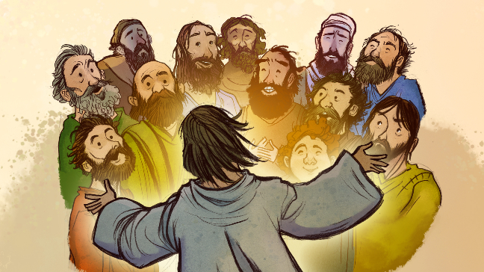
Notes:
In the passage we just listened to we heard Jesus talking to his disciples. The disciples were good friends of Jesus who believed in him and wanted to do what he said. The first of Jesus’ disciples were Peter, Andrew, James and John. These four, along with eight others were chosen by Jesus to be his special helpers. They were known as the Twelve Apostles.
In this passage we hear Jesus telling them to continue his work on earth. He asks them to teach and spread the Good News, to Baptise people and forgive sins. The Twelve Apostles were the first priests and Bishops of the Catholic Church.
Jesus’ followers today are called the Church. Today we are going to think about what it means to belong to the Church and to be a child of God.

Slide 5
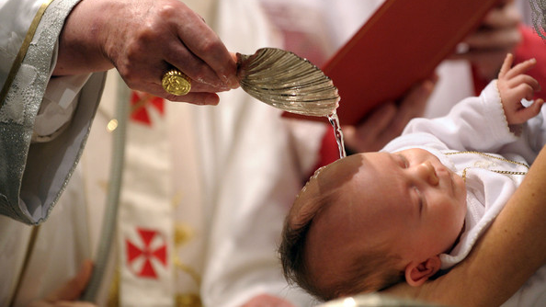
Baptised – a child of God
Notes:
When we are baptised, we become part of the Catholic Church. Holy Water is poured over our heads and the priest says “I Baptise you in the Name of the Father and of the Son and of the Holy Spirit”. From that moment we are part of God’s family – we are a child of God.
And just like your parents will expect you to behave a certain as part of their family or want certain things for you so does God. As part of God’s family, a child of God, we do our best to live as Jesus lived and God wants certain things for us in our life.
God’s family is made up of millions and millions of people spread all over the world. As part of God’s family we all try to carry on Jesus’ work on earth. This means we try to do our best to live the way he taught us, by loving God and loving others. We also try to go to Mass in our Church every Sunday. Although we can’t go to Church just now we can still watch Mass on the TV or on a computer.
Take a few moments now to think of your Baptism. Maybe you have some photographs you can look at. Who was there? What were you wearing? Do you still have your Baptismal candle?

Slide 6
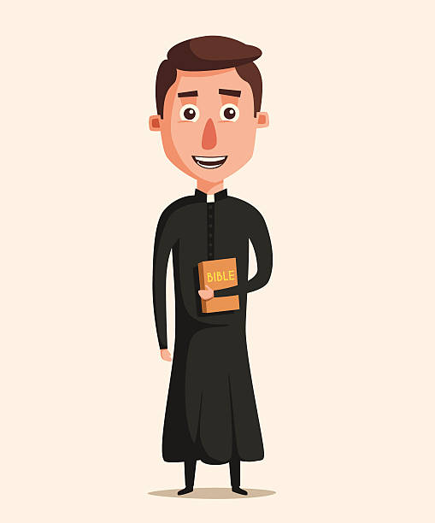
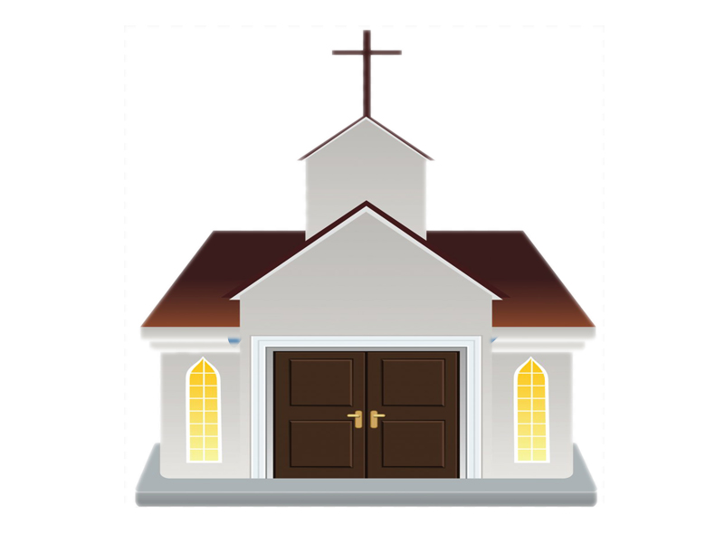
Notes:
In every Church there have a priest to lead us and help us. Priests do Jesus’ work in a special way, just like the Twelve Apostles did. Only priests can say Mass and forgive sins in Confession. They bring the Sacraments to the people of God and help us to be more like Jesus and to know and love him more.
Take a few moments to think about your parish priest. What is his name? Does he visit you in school sometimes? Maybe he has visited a sick relative or friend.

Slide 7
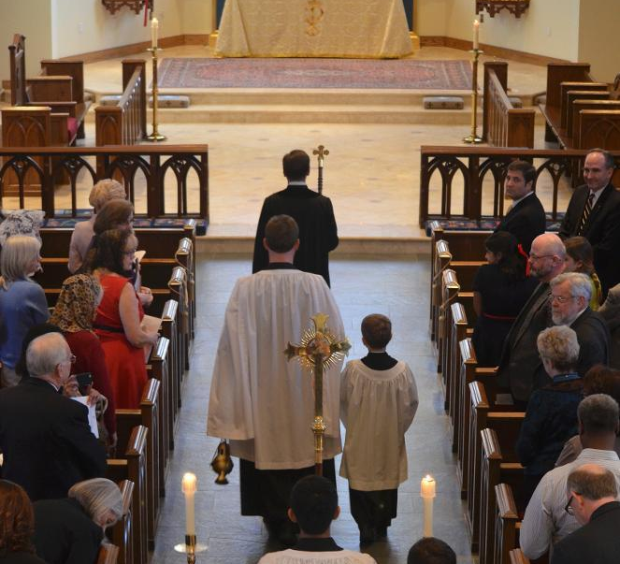
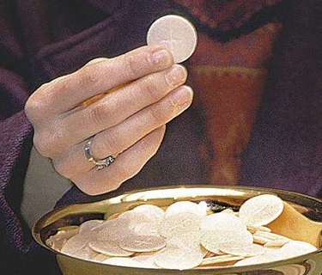
My Parish Community
Notes:
Every Church also has a number of people who help the priest. These might be pass keepers (who help to organise the celebration of Mass), readers (who read the Word of God at Mass), altar servers (who assist the priest during Mass), Eucharistic Ministers (who help distribute Communion) or Catechists (who help to teach young children in the parish). And lots, lots more.
There will also be lots of groups in your Church who work to help others in your local community. They might give food to those who don’t have enough to eat, they might pray for people, or help people who are finding things difficult in other ways. Many parishes also raise money for people all over the world who are not as fortunate as us.
In all of these ways, the people of God work together to continue Jesus’ work on earth just like his first disciples.
Take some time now to think about the ways that you might want to help your parish. Maybe you have a friend or family member who helps in the Church. You could ask them some questions about the work that they do. You could also prepare some questions for you parish priest and ask them when you see him school or at Church.

Slide 8
Activity
Using the ‘My Parish Community’ sheet and your parish website, find out more about your parish.
What groups do they have?
How do they help people in your community?
When does Mass take place?

Slide 9
Time of Prayer
Notes:
Remember that even though your parish is closed the Church still continues to God’s work. The priest and the parishioners will be praying for you as you prepare to receive the Sacrament of Reconciliation and you can keep them in your prayers too.
As a child of God we should do our best to live as Jesus lived, showing love to others (even when that’s difficult) and showing our love for God through our prayers and going to Mass. Our parish helps us to do this. Perhaps when you are out for your daily exercise you could walk past your church. Your Church might have a grotto or a shrine where you can say a prayer. When Churches reopen, in a few weeks make sure you go a visit Jesus. Maybe you will meet the priest or some of the helpers and you can ask them some questions about the work that they do.
Let’s bring our lesson to a close in prayer:
In the Name of the Father and of the Son …
Jesus, you gave us our priests and our parish so that we can meet you in the Sacraments and to help us continue your work on earth. Thank you for my family at home, in school and my family in the Church. Help us to grow in love for you and others as we prepare to receive the Sacrament of Reconciliation. Amen.
In the Name of the Father and of the Son and of the Holy Spirit. Amen

