Slide 1
S1 Confirmation Class Lessons
Come Holy Spirit, fill the hearts of your faithful and kindle in them the fire of your love.
Send forth your Spirit and they shall be created. And You shall renew the face of the earth.
O God, who by the light of the Holy Spirit, did instruct the hearts of the faithful, grant us in the same Spirit to be truly wise and ever to rejoice in His consolation. Through Christ our Lord. Amen.
Notes:
Please note: Before beginning this classwork, students will have hopefully completed Home Session: Part One During this session they will have learnt about what it means to be called to be a saint, focussing on Pope Benedict's message to young people when he visited the UK in 2010.
This session will recap on the seven sacraments and go on to concentrate specifically on the Baptism and Confirmation.
Begin the lesson with the prayer to the Holy Spirit. Click to display the prayer on the slide. Students should be invited to say the part of the prayer in bold.

Slide 2
Learning Intention: I am aware that in each of the sacraments God gives us a specific grace. ​
Success Criteria: ​
describe each sacrament and the grace that we receive from it​
demonstrate how the Sacraments strengthen my relationship with God and others
identify the key elements of the Sacrament of Baptism and Confirmation

Slide 3
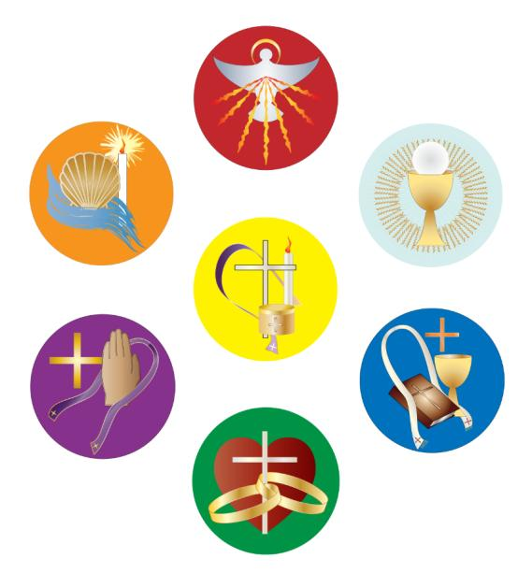
Match the Sacrament to the images above. You have 1 minute.
Notes:
Lesson Starter: Give the pupils 1 minute to name the Seven Sacraments on a whiteboard. Next, ask them to organise them into the three groups: Sacraments of Initiation, sacraments of healing and sacraments of mission.

Slide 4
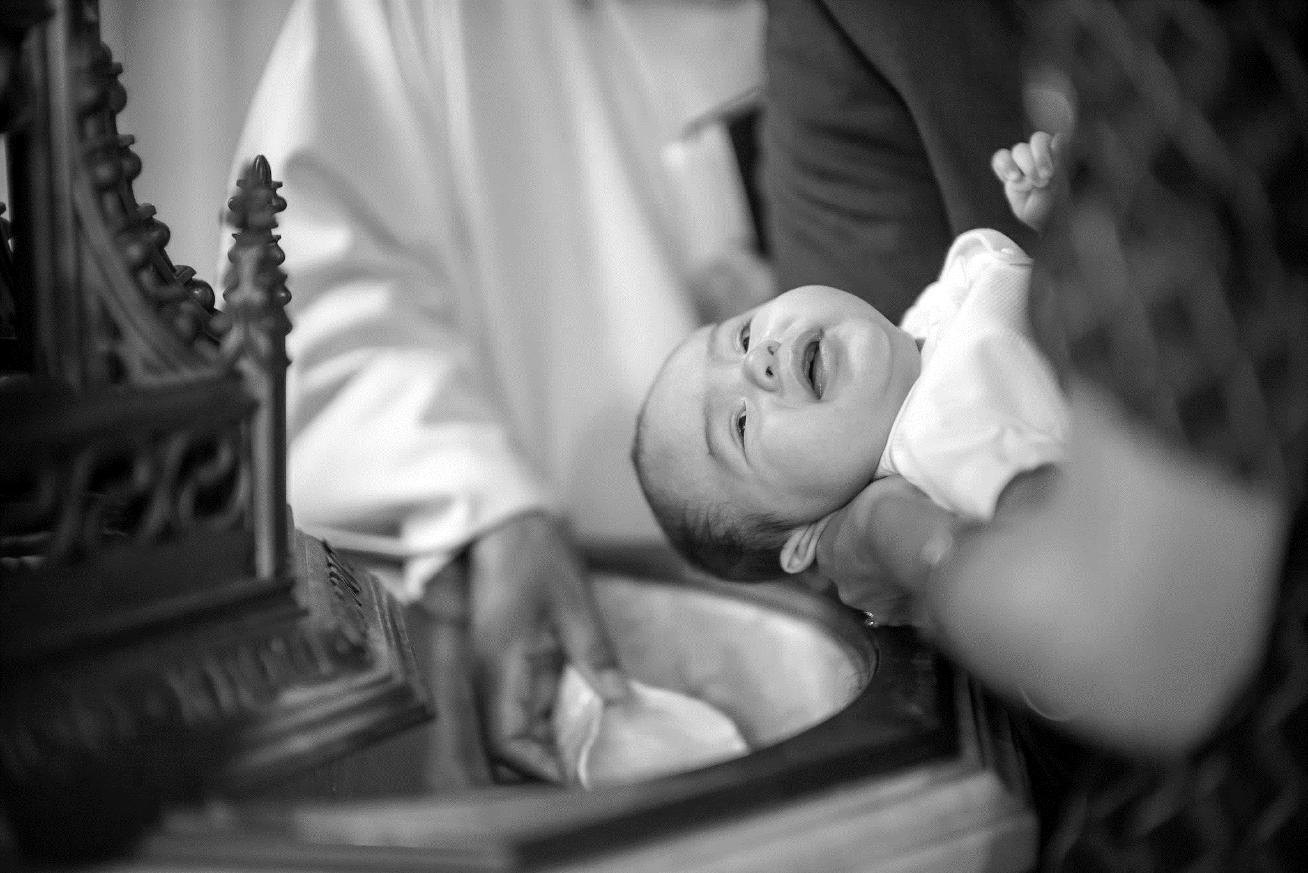
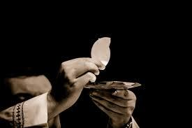
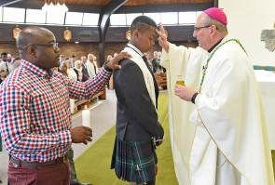
Confirmation
Sacraments of Initiation
Baptism​
Eucharist​
Cleanses us from sin and joins us with Christ
Nourishes us and unites us with Christ
We receive the Gifts of the Holy Spirit​
Notes:
Explain that through the Sacraments of Initiation: Baptism, Confirmation, Eucharist we enter the family of God.

Slide 5
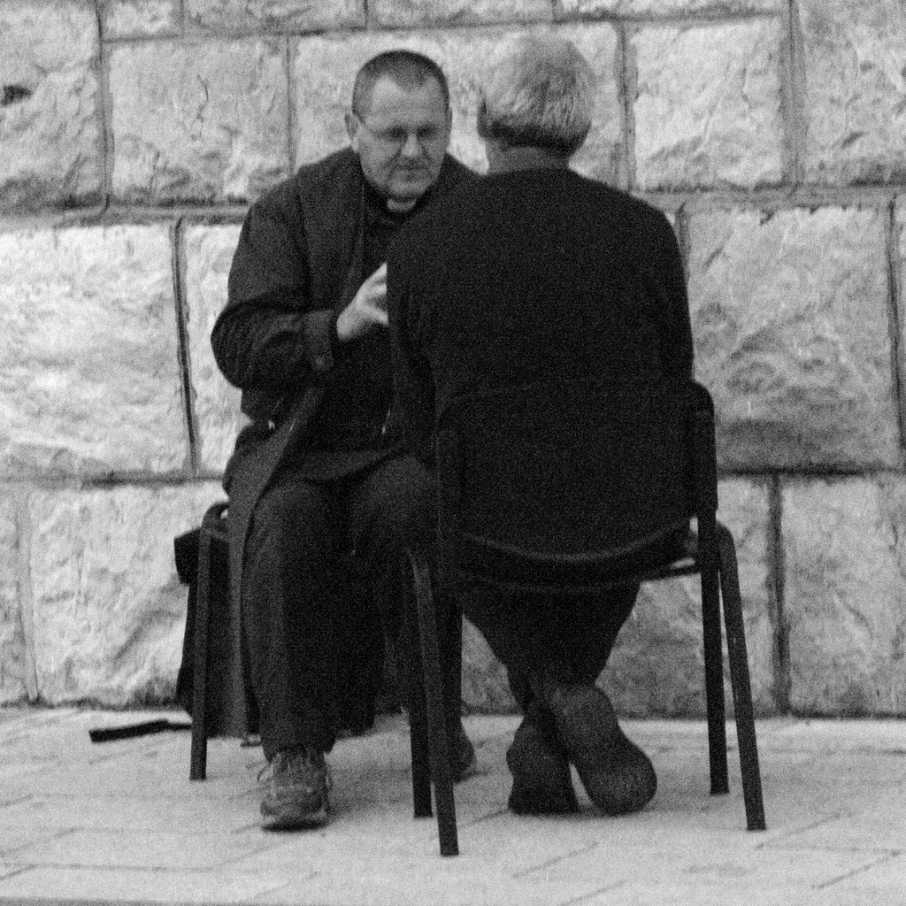
Sacraments of Healing
​Reconciliation
​Anointing of the Sick
Reconciles us with Christ
We are healed, strengthened and consoled
Notes:
Through the Sacraments of Healing: Reconciliation (Confession) and Anointing of the Sick, we are forgiven, strengthened and healed.

Slide 6
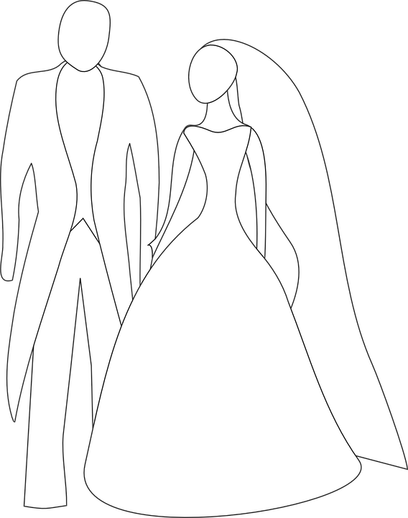
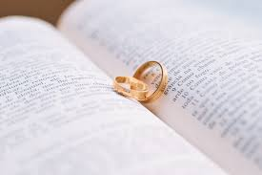
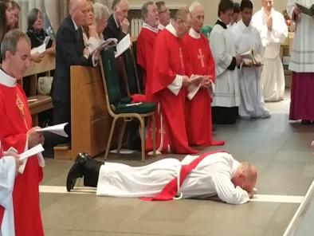
Sacraments of Mission
​Marriage
​Holy Orders
Perfects the couples love
Sharing in Christ’s Mission
Notes:
Explain that through the Sacraments of Initiation: Baptism, Confirmation, Eucharist we enter the family of God.

Slide 7
Why do we have the sacraments? Why do we need the sacraments?
Notes:
Ask students: Why do we have the sacraments?
Through the sacraments we communicate with God and He communicates with us. It is in the sacraments that we meet God. It is God who is truly present in the Eucharist, it is God who forgives our sins in Reconciliation etc. Jesus gave us the sacraments to nourish and strengthen our relationship with God.
Ask students: Why do we need the sacraments?
Through the sacraments we receive graces. These graces help us to grow in holiness and in our relationship with God. Each Sacrament gives us a specific grace which helps us on our journey to holiness.

Slide 8
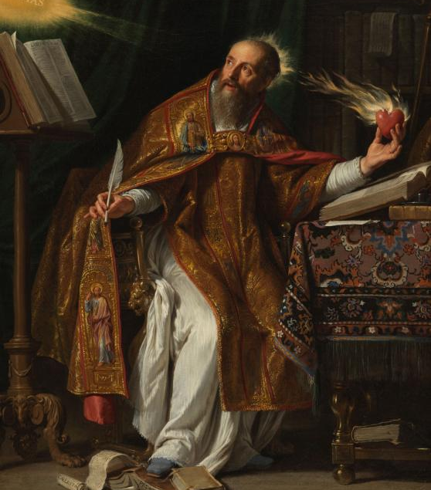
The sacraments are an outward sign of an inward grace...
Notes:
St Augustine described a sacrament as an outward sign of inward grace. Ask students what they think this means.
It sounds a very simple answer, but, to understand the depth of what that means, we need to probe rather more deeply. As Christians the journey of our lives is about coming to know God better, about building the kingdom of God here on earth, and, finally, to be with God forever.
We, as human beings, need signs and symbols often to express what cannot be expressed in words. We see around us constantly signs to simplify communication – road signs, badges and logos, signs that point to a simple reality. We use also more complex signs, symbols, pointing to another reality and manifesting that reality. Sacraments, particularly, depend on signs and symbols which signify a sacred reality.
Some examples of this: In the sacrament of Baptism water is poured on the head of the person being baptised. Water is usually associated with cleansing as we use it to wash and clean things. Through the sacrament of Baptism we are cleansed from sin. Water is the outward sign of what is happening in the sacrament.
In the sacrament of Eucharist we are spiritually nourished and united to Christ. The bread and wine, which becomes the Body and Blood of Jesus, are food which nourish us. The bread and wine is the outward sign of what is happening in the sacrament – we are being spiritually nourished.
The visible signs used in the sacraments: anointing with oil, light from a candle, water, etc. help us to experience, to touch, see, hear and feel the sacrament.

Slide 9
​
Activity:​
With a partner make a list of times when we might use signs to communicate something.
Notes:
Activity:
With a partner make a list of times when we might use signs to communicate something. Examples: We give chocolates/flowers/gifts to show that we love someone, send a card to show that we are thinking of people, likes on Facebook etc.
Just as signs help us to communicate with each other, they also help us to communicate with God. In the Catholic Church signs and symbols help us to better understand God and to participate in the liturgy, sacraments etc. They help us to speak to God in a deeper and more meaningful way.

Slide 10
Baptism and Confirmation
Notes:
We have been learning about the Seven Sacraments and the graces that we receive from them. Today we are going to look in more detail at two of those sacraments: Baptism and Confirmation. As we know, Baptism and Confirmation are both Sacraments of Initiation. The link between these two sacraments is very close.
In Baptism, we are brought into the community of the Church through the power of the Holy Spirit. Refer back to opening scripture passage “You will be Baptised with water and the Holy Spirit”.
At Baptism, we receive the first outpouring of the Holy Spirit.
At Confirmation, we receive a second outpouring of the Holy Spirit which deepens and strengthens the gifts of the Holy Spirit in us. In many ways Confirmation strengthens and confirms what happened at Baptism.

Slide 11
The Sign of the Cross
Anointing with the Oil of Catechumens
Baptismal Promises
Baptised with water
Anointing with the Oil of Chrism
Baptismal Candle
What are the essential parts of the Baptismal Rite?
Notes:
The meaning and grace received in the sacraments of Baptism and Confirmation are clearly seen in the celebration or rites. (The rites are the key elements of the celebration – the rituals) By looking in more detail at some of the essential parts of the celebrations we will find out more about them.
Activity
Give pupils 5 minutes in pairs to list the various parts of the Rite of Baptism of which they are aware.
Click to show the answers.

Slide 12
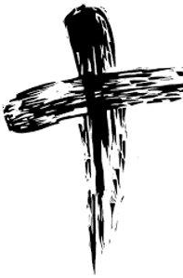
Indelible mark - received only once
Notes:
Some sacraments we receive many times such as Eucharist and Reconciliation but others we receive only once. Baptism is a sacrament that you will receive only once.
This is because through Baptism we enter a permanent relationship with Christ. If we think of our friendships, once we have made friends with someone our friendship might grow and change. We might not speak to each other for a while or even fall out and make up again but we are still in a relationship or friendship. Baptism marks entering into a relationship with Christ so it can only happen once. It leaves an ‘indelible’ or ‘permanent’ mark on the Baptised. This could be thought of a bit like an invisible birth mark – after Baptism you are marked forever as a child of God.

Slide 13
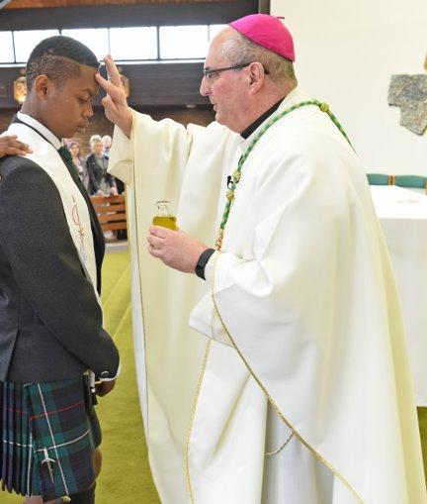
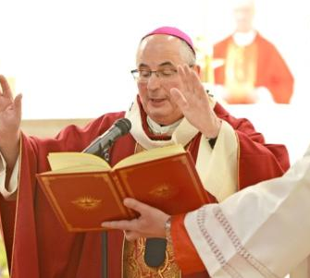
Notes:
We are now going to learn about the Confirmation rite in more detail.
Baptismal Promises - After the homily the Archbishop invites those to be confirmed to renew their Baptismal Promises.
In Baptism, our parents and Godparents make the Baptismal Promises on our behalf and a Baptised person should try to live out those promises for the rest of their lives. At Confirmation, we renew our Baptismal Promises and we agree to them – also agreeing to live by these promises with the help of the Holy Spirit.
The Laying on of hands – The Archbishop will stand and invite all to pray to the Father, asking that the Holy Spirit be poured out on these candidates and that they be made more like Jesus. He then extends his hands over the candidates before praying the Prayer for the Laying on of Hands. The silence that accompanies this prayer should be strictly observed.
Anointing with Chrism – After the Prayer for the Laying on of Hands the bishop anoints the candidates with the Oil of Chrism. During this anointing, the congregation continues to pray and to sing. Each candidate makes their way to the Archbishop accompanied by their sponsor who places his or her right hand on the right shoulder of the person who is to be confirmed. The Archbishop will ask each child for the name they have chosen for Confirmation. The Archbishop dips his thumb into the Chrism and makes the sign of the cross on the forehead of the one to be confirmed saying ‘(Name), Be sealed with the Holy Spirit’. It is at this point that the Confirmand receives the gift of the Holy Spirit.
The candidate replies: Amen. Meaning – yes, I accept, I do, I believe. By this anointing the confirmand receives the "mark," the seal of the Holy Spirit.

Slide 14
Indelible mark - received only once
Notes:
In both Baptism and Confirmation, we are anointed with the Oil of Chrism. It is by the anointing that we are given the mark / seal of the Holy Spirit. Confirmation is also a sacrament that we receive only once as we are marked forever as a child of God.
In the Old Testament anointing with oil was a sign of the presence of the Spirit of God, giving the person the power to do an important task/work for God. At your Confirmation, your anointing with the Oil of Chrism is a sign that you are being given the gifts of the Holy Spirit and that you have special work to do for God.
Briefly highlight the similarities between the two sacraments. Some of the preparations for Baptism and Confirmation are also similar – can they think of them? – choosing a name (in Baptism parents are also encouraged to choose a saint’s name) and sponsor/Godparents.

Slide 15
Notes:
Activity
Watch Busted Halo video: Why We Are Confirmed: https://www.youtube.com/watch?v=Qt32SyDWuW8
Discussion: In the video we heard that in the Sacrament of Confirmation we move from hearing the Gospel to sharing the Gospel, from becoming receivers to becoming doers. With the person next to you think about and duscuss what this means for you and how you can practically do this in you daily life.
Please note: Home Session: Part Three involves pupils renewing their Baptismal promises which will strengthen this learning.

Slide 16
The Holy Spirit: Gifts and Fruits

Slide 17
L.I. I can use Sacred Scripture to develop my understanding of the Holy Spirit.
Success Criteria:
Demonstrate an awareness of the various title of the Holy Spirit
Describe the importance of Pentecost for me as I prepare for Confirmation

Slide 18
You have 30 seconds to write down as many things as possible about the Holy Spirit...
Notes:
Give the pupils 30 seconds to write down as many things as they can think of about the Holy Spirit. This can be titles, gifts, imagery, etc. The group with the most correct answers could be given group points/personal points etc. They can earn bonus points for every piece of information that matches the suggestions on the PowerPoint.
Some possible answers are on the next slide.

Slide 19
Bonus Points
wind
Right Judgement
Paraclete
dove
The Spirit of the Lord
Fruits of the Holy Spirit
flame
Third Person of the Trinity
Notes:
Emphasise how much students already know about the Holy Spirit and explain to the pupils that today they are going to use Scripture to find out more about the Holy Spirit.

Slide 20
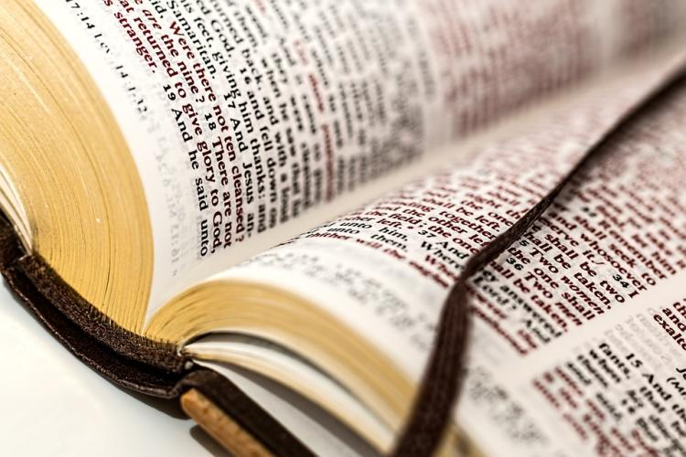
Sacred Scripture
Notes:
Remind the pupils that when we read Scripture we are reading the Word of God. God is the author of Sacred Scripture. God inspired the human authors of the sacred books. Today we are gathering information about the Holy Spirit from Scripture passages.

Slide 21
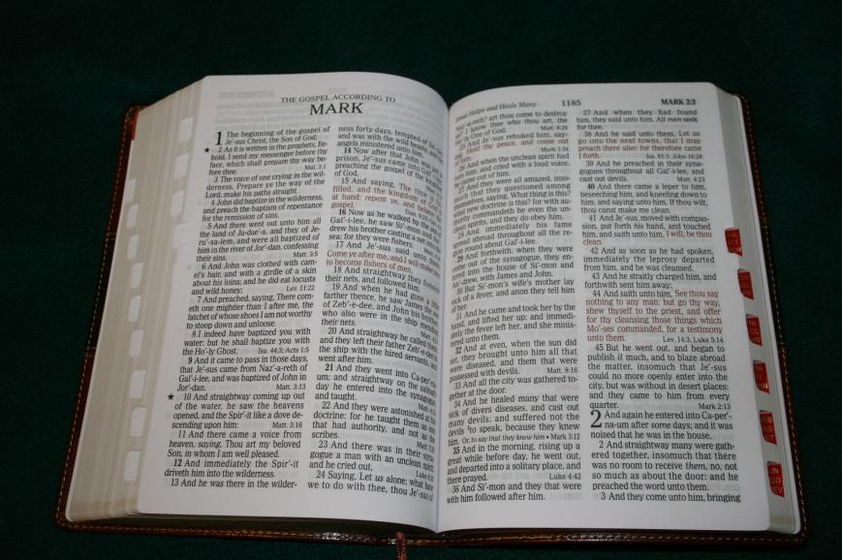
Mark 1: 9-13
Book Chapter Verse
Notes:
Recap how to locate Scripture passages.
Through Sacred Scripture God speaks to us. Before reading Scripture, we should get into the habit of praying to the Holy Spirit to help us to interpret/understand what we have read. Let’s say this short prayer together before we begin our task. Read the prayer on the next slide together.

Slide 22
Prayer to the Holy Spirit
‘Lord, open our hearts and minds by the power of your Holy Spirit, that as the scriptures are read and your Word is proclaimed, we may hear with joy what you say to us today.
Amen.’

Slide 23
The Holy Spirit in Scripture
John 14:16
Acts 2:4
Romans 8:26
Galations 5: 22-3
2 Corinthians 3:17
Acts 1:8
Luke 4:18
Acts 4: 29-31
Notes:
Activity: Pupils can choose three or more of the references on the slide to locate using their Bibles. Once they've found and read Scripture extract they should summarise what it tells us about the Holy Spirit. The first one is done for them.
Where Bibles are not available, the teacher is asked to select three references and lead pupils through what the extract tells us about the Holy Spirit.
Have the pupils share some of their answers with the class. Ask them if they have come across any titles for the Holy Spirit that they weren’t aware of.

Slide 24
Pentecost
Notes:
Explain that we're now going to focus on another part of scirpture that tells us more about the Holy Spirit: Pentecost. Before reading the story of Pentecost set the scene by asking the following questions: What situation were the apostles in? What had happened so far? Why were they in the upper room?
Read the story of Pentecost (Acts 2:1-13)
After you have read the passage pause to allow time to reflect and then ask the pupils to share what they thought/how they think the disciples felt etc.

Slide 25
Think...
1. What was the mission that Jesus gave to the apostles?
2. What gifts did the Holy Spirit bring the apostles?
3. Why were these gifts appropriate?
4. Take a moment to think about what God is calling you to do – what gifts do you think you will need in order to do this?
Notes:
You may wish to answer the first three questions as a whole class and the last, more personal question, as an individual reflective or written activity.
Explain to the pupils that when they are Confirmed it will be like a mini Pentecost.

Slide 26
Pentecost: Birthday of the Church
Notes:
Explain to the children that Pentecost was the beginning of the ministry of the apostles but it was also the beginning of the Church. When we celebrate Pentecost we celebrate the birthday of the Church.
Watch the short film on Pentecost: http://www.catholic.org/lent/pentecost.php

Slide 27
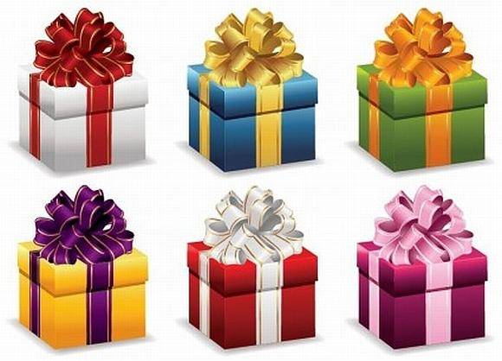
The Gifts of the Holy Spirit
Notes:
Ask pupils what they can recall about either the gifts or the fruits of the Holy Spirit. Explain that we are going to look and the gifts and fruits in a little more detail and we'll begin with the seven Gifts of the Holy Spirit.
We know about the Seven Gifts because in scripture Isaiah prophesied that Jesus would have them when the Spirit rested upon Him. We also receive the Gifts of the Holy Spirit in the Sacrament of Confirmation.
Read Isaiah 11:1-5 – text on the following slide

Slide 28
Isaiah 11:1-5 The Branch from Jesse
A shoot will come up from the stump of Jesse; from his roots a Branch will bear fruit. The Spirit of the LORD will rest on him— the Spirit of wisdom and of understanding, the Spirit of counsel and of might, the Spirit of the knowledge and fear of the LORD— and he will delight in the fear of the LORD. He will not judge by what he sees with his eyes, or decide by what he hears with his ears;
but with righteousness he will judge the needy, with justice he will give decisions for the poor of the earth. He will strike the earth with the rod of his mouth; with the breath of his lips he will slay the wicked. Righteousness will be his belt and faithfulness the sash around his waist.
Notes:
Activity
Distribute the Gifts and definitions worksheet and ask pupils to match each gift with the correct definition. This could be done individually or in pairs/small groups.
Once they have matched the statements ask the pupils to order them starting with the Gifts that they feel they require most to live as a witness for Christ. Please see the answer sheet and take the pupils through the correct answers.
Note: various definitions of the Gifts of the Holy Spirit can be found but it is helpful if teachers use the definitions provided in this resources

Slide 29
Why do we need the Gifts of the Holy Spirit?
Just like the Apostles we need God’s help in order to be effective witnesses for Christ.
Notes:
As a plenary for this section, ask pupils the question on the slide. Then click for the answer: Just like the Apostles, we need God's help in order to be effective witnesses for Christ.

Slide 30
The Fruits of the Holy Spirit
Notes:
Ask pupils what do they know about the Fruits of the Holy Spirit?
Ask them what we mean when we say that something bears fruit? We are talking about the results of an action/favourable outcome.

Slide 31
What does Scripture tell us?
In Matthew 12:33-34, Jesus says,
“Make a tree good and its fruit will be good, or make a tree bad and its fruit will be bad, for a tree is recognised by its fruit.” “A tree will be recognised by its fruit.”
That means we will know what kind of tree it is by the fruit it has on it.
Notes:
Explain that we can use this example to help us to understand the Gifts and Fruits of the Holy Spirit. When we are open to the Holy Spirit, his Gifts make us more like Jesus and lead us to act in certain ways. This ‘bears fruit in our lives’ and we begin to see the fruits of our actions. We know from our activity earlier on that in St Paul’s letter to the Galatians 5:22-23, we are told about the Fruits of the Holy Spirit. We will watch a short video that tells us a bit more about this (clip link on next slide).

Slide 32
Notes:
Input
So as we heard in the video the Fruits of the Holy Spirit are: love, joy, peace, patience, kindness, goodness, generosity, gentleness. Faithfulness, chastity, modesty, self-control.
When we pray for the Gifts of the Holy Spirit, and allow Him to work in our lives, we begin to see the signs of his presence in the way that we behave and treat others. When we are loving, kind, patient etc. (demonstrating the Fruits of the Holy Spirit) these are the fruits of the Holy Spirit’s work in us, helping us to live as followers of Jesus.
If we think back to the letter from Pope Benedict XVI in Lesson 1 Pope Benedict XVI describes this when he says:
“Once you enter into friendship with God, everything in your life begins to change. As you come to know him better, you find you want to reflect something of his infinite goodness in your own life. You are attracted to the practice of virtue. You begin to see greed and selfishness and all the other sins for what they really are, destructive and dangerous tendencies that cause deep suffering and do great damage, and you want to avoid falling into that trap yourselves. You begin to feel compassion for people in difficulties and you are eager to do something to help them. You want to come to the aid of the poor and the hungry, you want to comfort the sorrowful, you want to be kind and generous. And once these things begin to matter to you, you are well on the way to becoming saints.”

Slide 33
The Fruits of the Holy Spirit
Love
Gentleness
Modesty
Kindness
Peace
Joy
Chastity
Generosity
Goodness
Patience
Self-control
Faithfulness
Notes:
Activity
Split the pupils into groups and give each group a Fruit of the Holy Spirit. They should first discuss the Fruit and come up with a definition of it.
Can they think of any saints/people they know who have/do demonstrate this Fruit in their lives?
Please note: This learning will be brought together in Home Session: Part Four. This looks at the founder of Mary's Meals – Magnus McFarlane-Barrow as an example of someone who demonstrates the gifts and fruits of the Holy Spirit in his life.

